Slide 1
Microsoft Premium License Optimization Strategies Per App or Per User?
By CRMaaS Power Platform Admin Team
Sept 2025

Slide 2
Key Definitions Per USER vs Per APP | The Differences Between These Two Premium License Types
Per USER: (Target User: Developers)
A single license per user.
Per APP aka App Pass: (Target User: Daily User)
A single license allowing one user access to an App.
Allows user access to unlimited apps, portals, and use of Premium connectors across all environments where access has been given.
A single license is consumed when a user becomes associated with an app (or portal). The App must be activated to use App Pass Licenses in settings before sharing with a user. All App Pass are allocated to environments by a Power Platform Admin.

Slide 3
Why Use Per App (aka App Pass) Licenses?
Price:
The cost per person is less expensive.
Easy to manage:
A single license (app pass) allows a single user to access one app in a specific environment.
Once allocated to an environment, app passes are automatically assigned to the app/user (those without premium licenses) when an app in that environment has.
Per-app license switched to the ON position. (see next slide, slide 4)
The user has been given access to the app either as an individual or a member of a security group.
Typically, the app is shared to select users via a shared link.
Comparing Use Types:
Developers require the Per User license when working across PROD, UAT & DEV environments.
Most Per App Pass users are found in the Production environments as an app user.
Per App Passes are considered Add-On Capacity:
Allocation is applied in the Admin Center.
In App Settings, enable the “per-app licensing” toggle switch.
Note, if add-ons have not been added to an environment, the app licensing toggle is disabled.

Slide 4
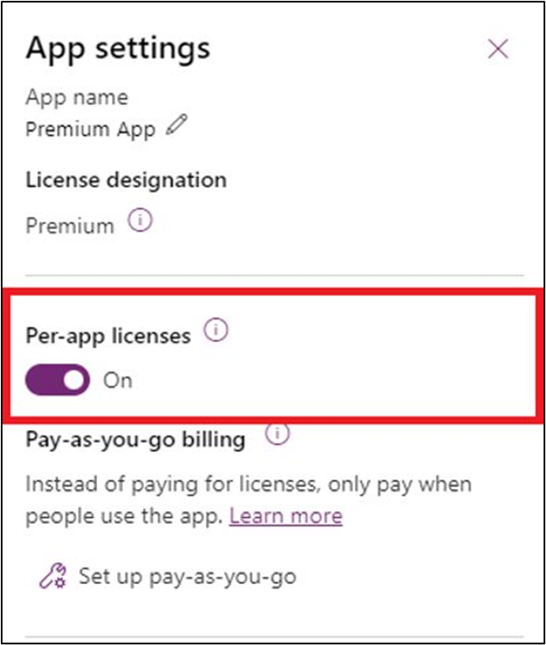
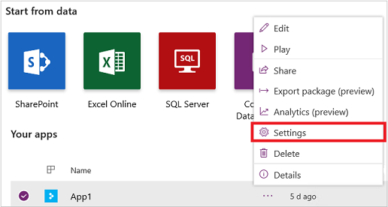
Set up apps to use per app plans reference link: About Power Apps per app plans - Power Platform | Microsoft Learn
After an admin allocates Power Apps per app plan to an environment, they're assigned to unlicensed users when an app in that environment is shared with them.
Follow these steps to turn on assigning per app plans for users when an app is shared with them:
Note
In the default environment, go to app settings > Pass Assignment and set the Auto assign per app passes toggle to Yes.
Choose the app in Power Apps.
Select ... > Settings.

Slide 5
“Active Users” “Active Apps” “Per App Passes”
Active Users: Refers to individuals who interact with the app, such as opening it or using its features.
Active Apps: Indicates applications that are currently being used by users within a specific environment.
Per App Passes: These are licenses assigned at the environment level, allowing users to run one application or portal for a specific business scenario.
Considerations & Tips:
Keeping a tally of the number of Per App Licenses needed.
Tip: Match the number of Active Apps vs Active Users in each environment.
A user will trigger the consumption of single pass upon use.
Tip: The license is associated with the app - not a user.
The App Pass allocation resets after 30 days of user inactivity.
Tip: Maintain enough Passes to allow for any overlapping.

Slide 6
App Pass Consumption & Reclaiming
Trigger:
The pass is consumed when user opens app.
Reclaiming:
Users with new Per User license automatically release app pass
App pass resets after license is removed plus 30 days of inactivity
Admin Center Usage Tracking:
Monitor active/consumed app passes
An Environment Admin has access to view Shared, Active users and App GUID.
Download is available to get a list of name of those users and the license type.
See next page for a view of the Admin Center.

Slide 7
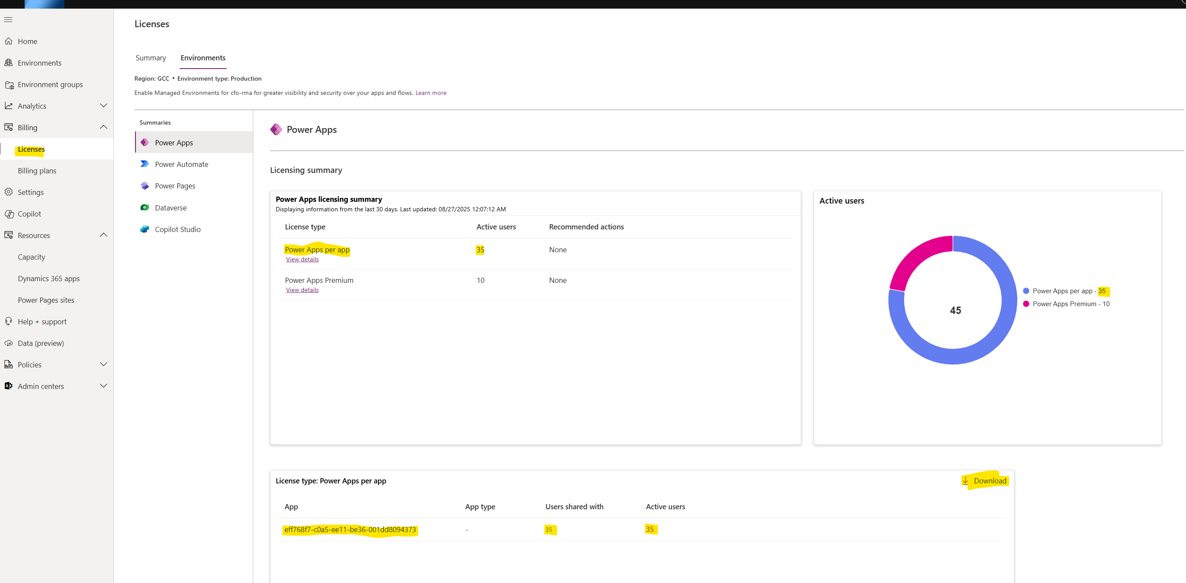
Power Platform Admin Center License View

Slide 8
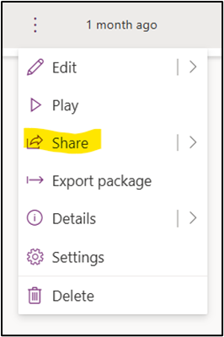
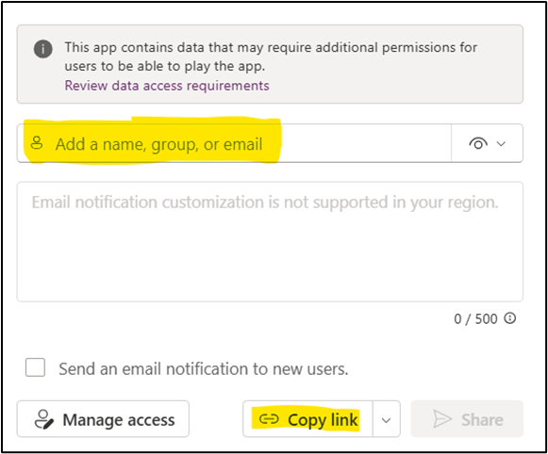
Control Access via Security Groups
Applying Per-app licenses to specific users or Groups.
Request the creation of security groups in Entra ID. (Formerly named: Active Directory)
Create ServiceNow ticket requesting security groups.
{insert naming convention doc}.
Using the app's ellipse, click Share and insert security group.
Copy app link to share.

Slide 9
Summary
In the Production Environment:
Remove unnecessary per User license except for developers.
Know the ratio of apps/users when calculating the per App licenses needed.
For example, if there are two app being used, each user could consume 2 per app licenses, one for each app being used.
Make sure the App-Pass switch is turned on. Turn off any app pass switch that is not being used in all environments. See Slide 4
Keep good records of users & inventory of users active in each security group.
If needed, email crmaas@hq.dhs.gov for group role counts.

